Slide 1

Drama At Cornwallis Academy
Year 8 – LESSON 4
Lesson Objective:
-To continue to demonstrate an understanding of how show and develop a character
-To devise a Murder Mystery play.
Success Criteria:
Performing and Creating
Level 3
I can sustain a role that I have created for some of the performance. I am more comfortable being led by others in a group situation.
Level 4
I can stay in role for good parts of my performance, occasionally struggling to keep focused. I will make a reasonable contribution to my groups work, sharing some simple ideas.
Level 5
I can stay in role for most of the performance with few distractions. I will make a positive contribution to a group, sharing ideas and showing some leadership.
Level 6
I can consistently stay in role for the whole of the performance. I Contribute ideas very well to the group I’m in and am capable of showing good leadership skills

Slide 2
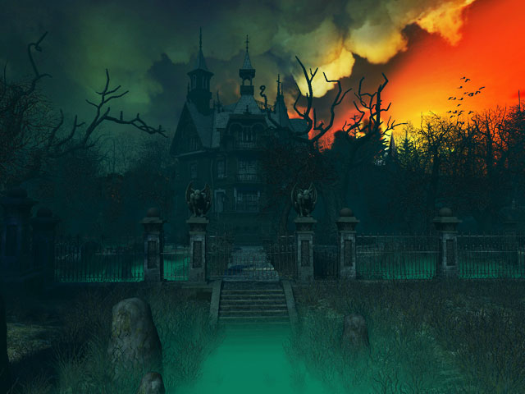
Lesson Objective:
-To continue to demonstrate an understanding of how show and develop a character
-To devise a Murder Mystery play.
.
Activity 1 – Murder Mystery game 4 – Who is the murderer?
Success Criteria:
Creating and Performing
Level 3
I can sustain a role that I have created for some of the performance. I am more comfortable being led by others in a group situation.
Level 4
I can stay in role for good parts of my performance, occasionally struggling to keep focused. I will make a reasonable contribution to my groups work, sharing some simple ideas.
Level 5
I can stay in role for most of the performance with few distractions. I will make a positive contribution to a group, sharing ideas and showing some leadership.
Level 6
I can consistently stay in role for the whole of the performance. I Contribute ideas very well to the group I’m in and am capable of showing good leadership skills

Slide 3
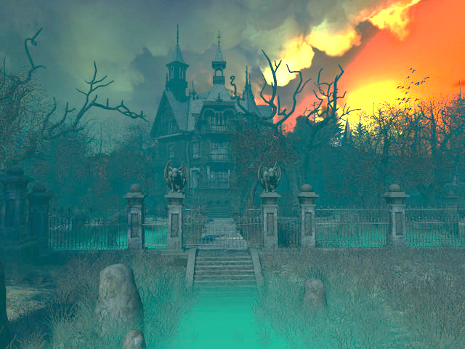
Lesson Objective:
-To continue to demonstrate an understanding of how show and develop a character
-To devise a Murder Mystery play.
WARM-UP – Your Character
Having now re-capped themselves on the decisions they have made about their characters play an introductory game with pupils. Tell students to think about how their character would talk, stand, walk, their job, personality etc… Standing in a circle, get students, in pairs, to walk into the circle and great each other as their character.
Success Criteria:
Creating and Performing
Level 3
I can sustain a role that I have created for some of the performance. I am more comfortable being led by others in a group situation.
Level 4
I can stay in role for good parts of my performance, occasionally struggling to keep focused. I will make a reasonable contribution to my groups work, sharing some simple ideas.
Level 5
I can stay in role for most of the performance with few distractions. I will make a positive contribution to a group, sharing ideas and showing some leadership.
Level 6
I can consistently stay in role for the whole of the performance. I Contribute ideas very well to the group I’m in and am capable of showing good leadership skills

Slide 4
Murder Mystery Assessment
I will now give you back your planning sheets and give you 3 minutes to look over the decisions you have made about your characters.

Slide 5

Task 1 – Overview of Mystery
Having now discussed and made decisions as a group about your Murder Mystery, you will need to complete an Overview sheet outlining clearly your Murder Mystery. It is vital that you keep these a secret from the other groups. (7 minutes)
Murder Mystery Assessment

Slide 6
Task 2 – Character sheet
Having now fully planned out the story you will need to log the decisions that you have made about each characters involvement. As a group, using the Character sheet, you will need to log each character’s name, motive, alibi and clue that the audience will see.
Murder Mystery Assessment

Slide 7
Task 3 –Devising your play
Using their planning sheets you will now devise your Murder Mystery’s. You will have 15 minutes to work on your beginning middle and end.
Murder Mystery Assessment

Slide 8
Questions and Answers
What do you need for next lesson?
What you need to think about in order to be fully prepared?
What level are you on and why?
Murder Mystery Assessment

